Slide 1
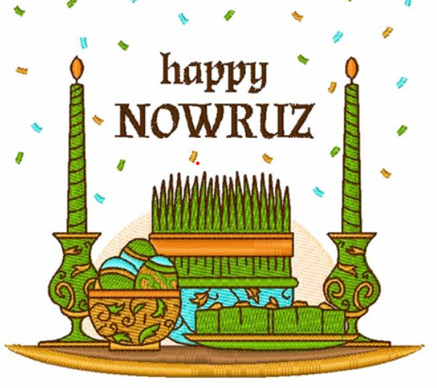

Slide 2
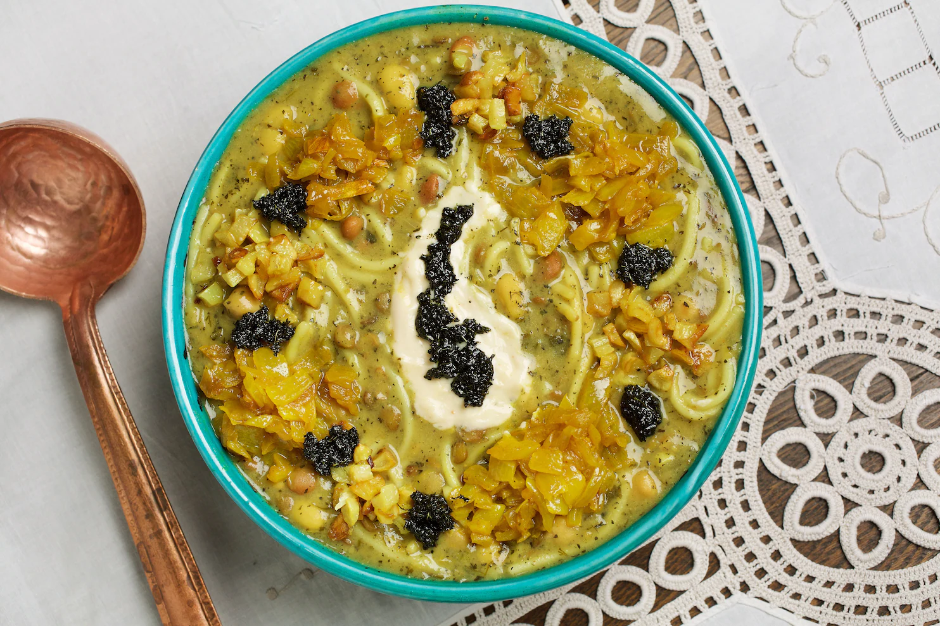
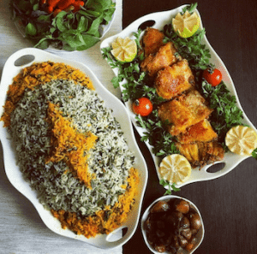
Just like other cultural celebrations, many special foods are prepared during Nowruz, depending on the country of origin. One of these dishes, ash-e resteh or noodle soup, is typically served on the first day of Nowruz. This soup is special because the knots of noodles symbolize the many possibilities in one’s life, and it is thought that untangling the noodles will bring good fortune. Another Nowruz dish is called sabzi pollo mahi (fish served with a special rice mixed with green herbs). The rice is made with many green herbs and spices, which represent the greenness of nature at spring. Special sweets are also served during Nowruz. Traditional items include naan berengi (cookies made from rice flour); baqlava (flaky pastry sweetened with rosewater); samanu (sprouted wheat pudding); and noghl (sugar-coated almonds).

Slide 3
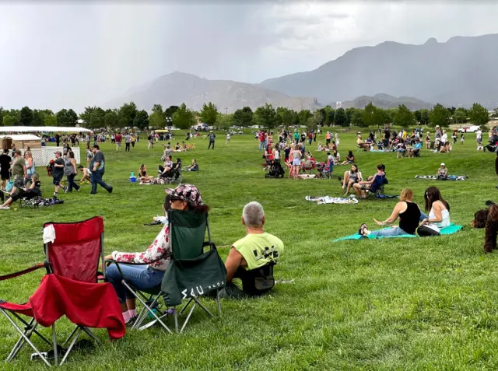
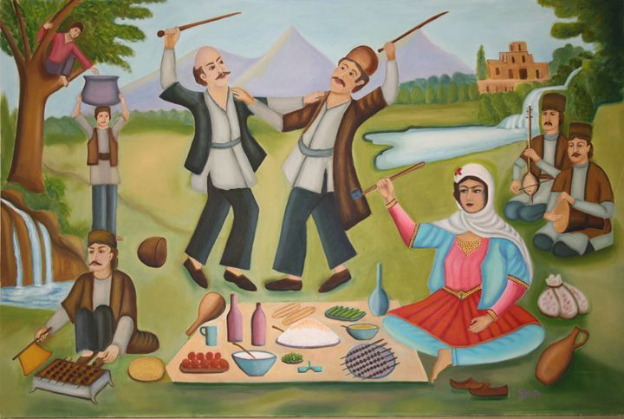
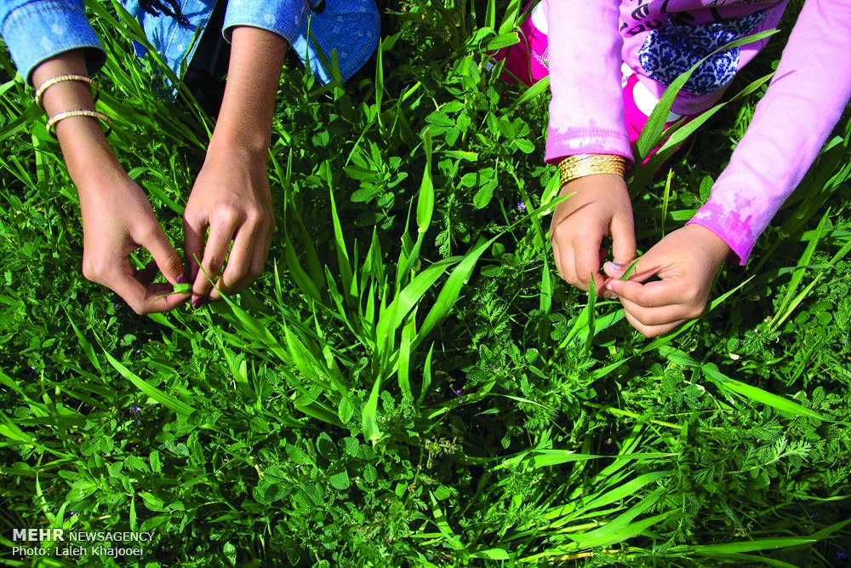
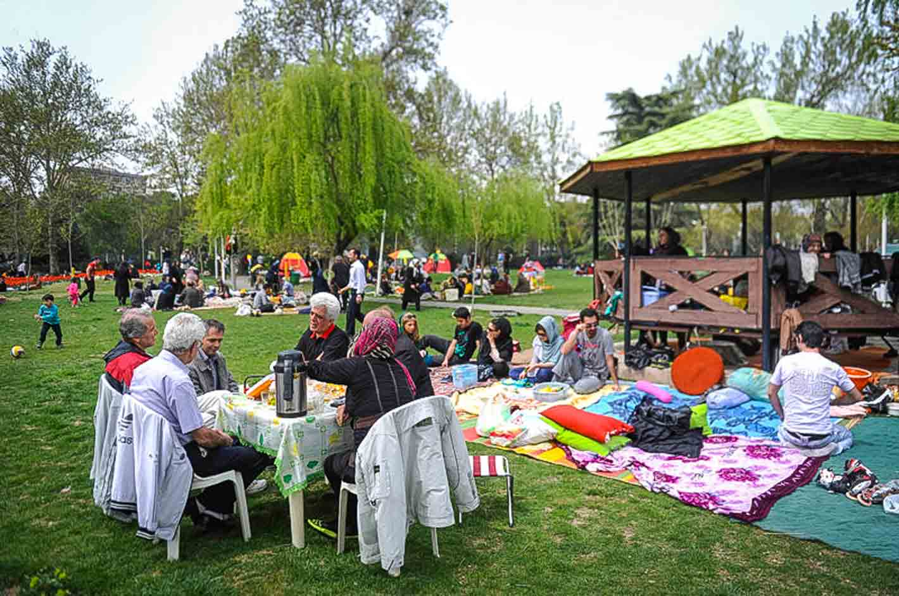
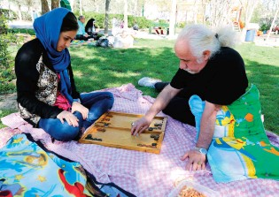
Nowruz
Celebrations
Sizdah Bedar The 13th day of the New Year festival (meaning 'thirteen outdoors’)

Slide 4

